Slide 1
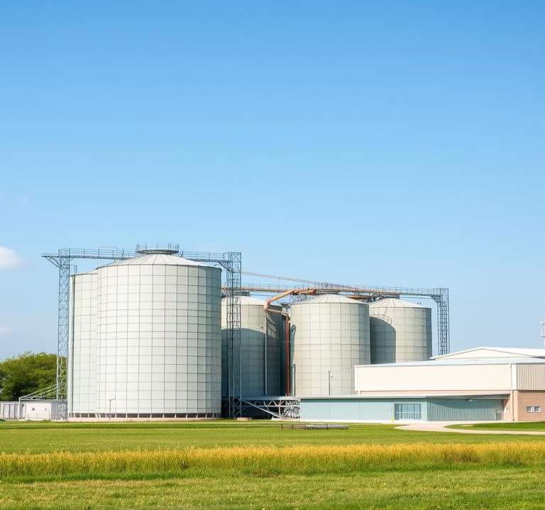
TAU INVEST
S O L U T I O N S
TAU INVEST SOLUTIONS PRESENTS
Oil Processing
Plant
TOO «PCD Group» · Almaty Region, Kazakhstan
Operating full-cycle soybean and sunflower oil production plant, including meal — a ready asset with potential for multiple growth without additional capital expenditure.
200+120
1,206 bln ₸
t/day — soybean and sunflower
revenue over 12 months
4 years
0 CAPEX
payback on acquisition
₸1.2 bln already invested

Slide 2
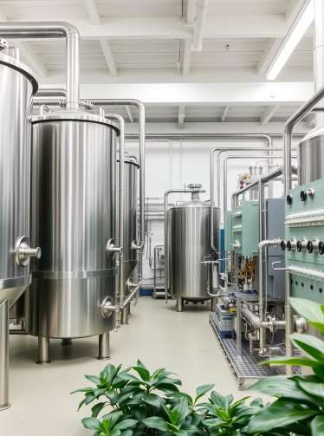
TAU INVEST
PRODUCTION CAPACITY
S O L U T I O N S
Full-Cycle Oilseed Processing
The plant carries out full-cycle production of soybean and sunflower oil, as well as meal. Average plant utilization is 59% of design capacity — significant room for growth without equipment investment.
200
120
40
Soybean, t/day
Sunflower, t/day
Refining, t/day
actual load: 120 t/day (60%)
actual load: 70 t/day (58%)
average plant utilization — 59% of design capacity
59%
average plant utilization of design capacity — potential for nearly 2x growth on existing assets
2

Slide 3
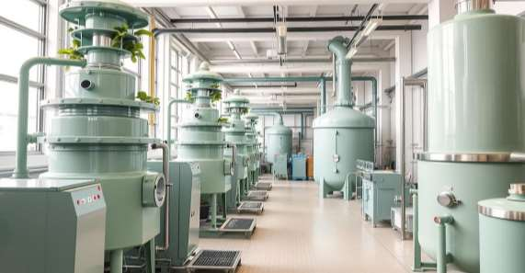
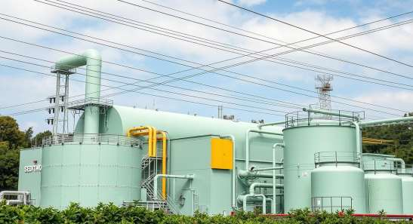
TAU INVEST
EQUIPMENT AND INFRASTRUCTURE
S O L U T I O N S
Modern Equipment and Robust Utilities
Core Production Equipment
Developed Infrastructure and Utilities
The plant is equipped with modern machinery, including presses, extractors, roasters, and a vacuum distillation system, ensuring a full oil-refining cycle.
The plant is connected to robust utilities: power supply (1,200 kW), steam boiler (8 t steam/hour), water supply (up to 8 t/hour), and two gas holders (50 m³ each).
3

Slide 4
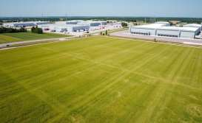
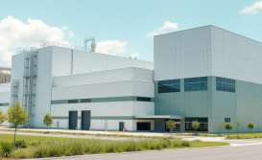

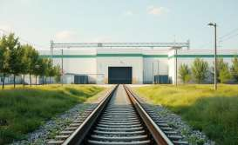
TAU INVEST
EQUIPMENT AND INFRASTRUCTURE
S O L U T I O N S
Land, Buildings, Self-Sufficiency, Logistics
Land Plot
Buildings
Utilities
Logistics
A large plot of 3.68 ha, classified as industrial land — allowing further development and capacity expansion. The plot is available for freehold registration, ensuring long-term stability.
Total production and warehouse space of 3,200 m², including a modern administrative building: enough room for equipment, raw material and finished goods storage, and comfortable staff facilities.
The facility is fully self-sufficient: its own water supply from a borehole, gas holders for heating and production needs, and a boiler house rated at 8 tons of steam per hour — independence from municipal networks.
Developed logistics infrastructure, including convenient rail access — critical for raw material delivery and finished goods shipment. The site has a developed security system for assets and personnel.
4

Slide 5
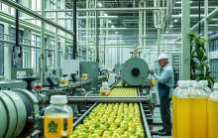


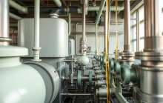

TAU INVEST
TEAM AND STRUCTURE
S O L U T I O N S
54 Employees Across Five Key Departments
The plant has a qualified team distributed across key departments. Most employees are engaged in core operational processes — production, power engineering, and refining.
18
10
4
10
12
Production
Power Engineering
Laboratory
Refining
Administrative Staff
Core process of converting raw material into finished product
Uninterrupted operation of all plant energy systems
Quality control of raw materials and finished product at every stage
Oil purification to achieve high quality standards
Overall coordination and administrative support for the plant
Total: 54 employees
5

Slide 6

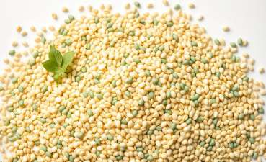
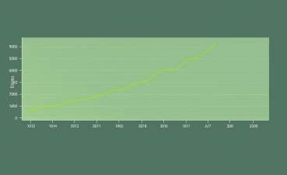
TAU INVEST
FINANCIAL PERFORMANCE · 12 MONTHS
S O L U T I O N S
Revenue, Cost of Sales, EBITDA
Overview of key financial indicators over the past 12 months, showing the main revenue and cost items, as well as estimated profit.
Revenue
Cost of Sales
EBITDA (estimated)
₸1,206 bln
98% of revenue
₸85–100 mln
over the past 12 months
main line item — raw material procurement
7–8% of revenue
6

Slide 7
TAU INVEST
BENEFITS OF ACQUISITION
S O L U T I O N S
Multiple Growth Without Additional Investment
Acquiring the plant offers significant growth in revenue and EBITDA, fast payback, and no need for additional capital expenditure.
POTENTIAL REVENUE
POTENTIAL EBITDA
₸2.2–2.4 bln/year
₸250–300 mln/year
at 100% utilization (+95%)
+250% growth vs current level
PAYBACK
CAPEX NOT REQUIRED
4 years
₸1.2 bln
fast return on investment
already invested in plant assets
7

Slide 8
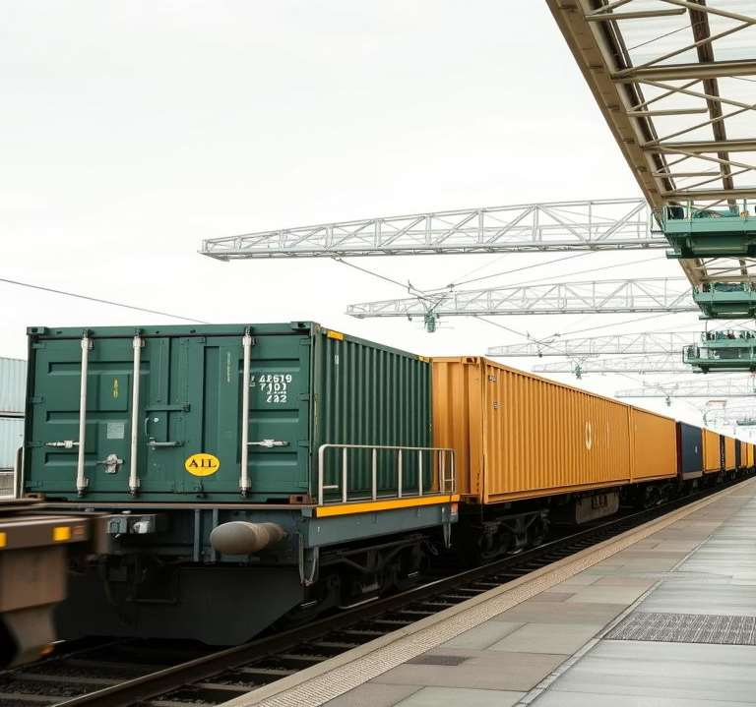
TAU INVEST
S O L U T I O N S
EXPORT POTENTIAL
Ready for Export and Retail
Markets
China, Uzbekistan, EAEU countries
Packaging
1 and 5-liter (PET) — retail-ready
Logistics
Rail access, warehouse infrastructure
8

Slide 9
TAU INVEST
INVESTMENT CASE
S O L U T I O N S
Investment Advantages and Growth Opportunities
Investment Advantages
Growth Opportunities
1
Multiple Growth
Capacity Utilization
potential growth in EBITDA and revenue
up to 95–100%
2
Geographic Advantage
Packaging Line Launch
proximity to raw material base
and retail channel
3
Minimal CAPEX
Export Growth
all investments already made
up to 50% of sales
4
High Residual Value
Cost Reduction
plant assets
through automation (8–12% savings)
5
Operating Plant
Margin Growth
ready to scale
from 7% to 25% with export and packaging
9

Slide 10
TAU INVEST
HOW TAU INVEST SOLUTIONS HELPS
S O L U T I O N S
One Local Partner for the Entire Deal
Tau Invest Solutions supports the investor throughout the entire investment cycle in Kazakhstan — from asset verification and deal structuring to financing, sales, and operational support.
Deal & Due Diligence
Financing & Banks
Sales & Distribution
Verification of the asset, land plot, and permitting base · contract work · LLP registration and corporate law in Kazakhstan · offshore holding structures
Preferential financing for the deal and working capital as a single package via DBK, Damu, QIC, and KazakhExport
Search for distributors and retail chains in Kazakhstan, entry into B2B procurement and tenders — including launch of packaged 1L and 5L product
Export Support
Government & Certification
Personnel & Operational Support
Customs clearance, certificates of origin, logistics to China, Uzbekistan and EAEU countries, export contract insurance via KazakhExport
Liaison with akimats and ministries · EAEU technical regulations, GOST, and sanitary certificates for oil & fat products
Staff recruitment, relocation of the investor's team, ongoing management and post-deal support
10

Slide 11
TAU INVEST
S O L U T I O N S
GET IN TOUCH
Let's Discuss Acquiring the Plant in Kazakhstan
Share your investment criteria — we'll respond within one business day with proposed next steps.
EMAIL
info@tauinvestsolutions.com
Deal Object
PHONE
+7 702 975 6366
OFFICE
Almaty, Kazakhstan, Zhetysu-3 district,
Fortune Business Center, office 36
Oil-Processing Plant, TOO «PCD Group», Almaty Region, Kazakhstan
WEBSITE
tauinvestsolutions.com
11

